Slide 1
Introduction to Cloud

Slide 2
What is the Cloud?
Cloud computing is a model for enabling ubiquitous, convenient, on-demand network access to a shared pool of configurable computing resources (e.g. networks, servers, storage, applications, and services) that can be rapidly provisioned and released with minimal management effort or service provider interaction.

Slide 3
On-demand self service
All cloud providers have a dashboard through which the customers can control the services that the provider offers. Hence the name on demand self service.

Slide 4
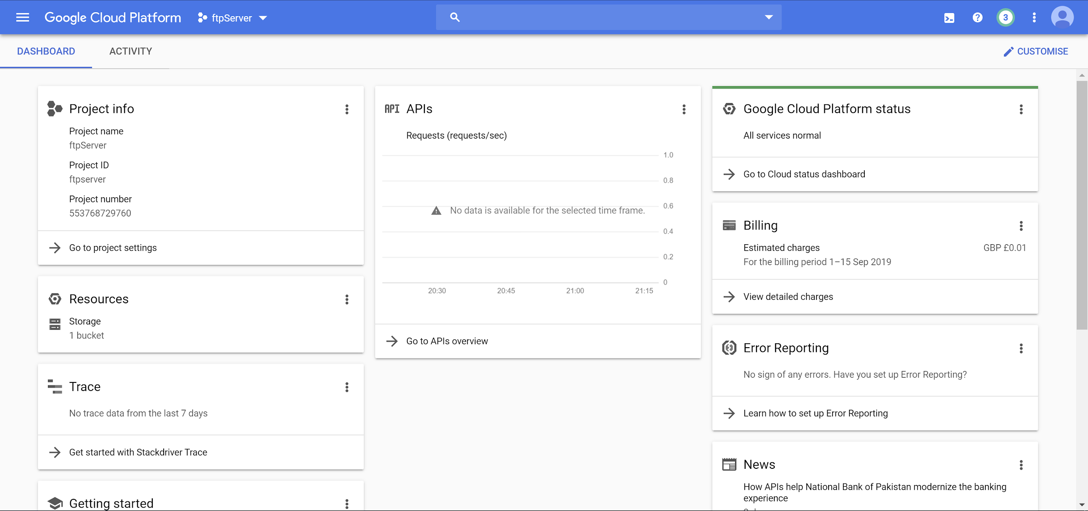
GCP

Slide 5
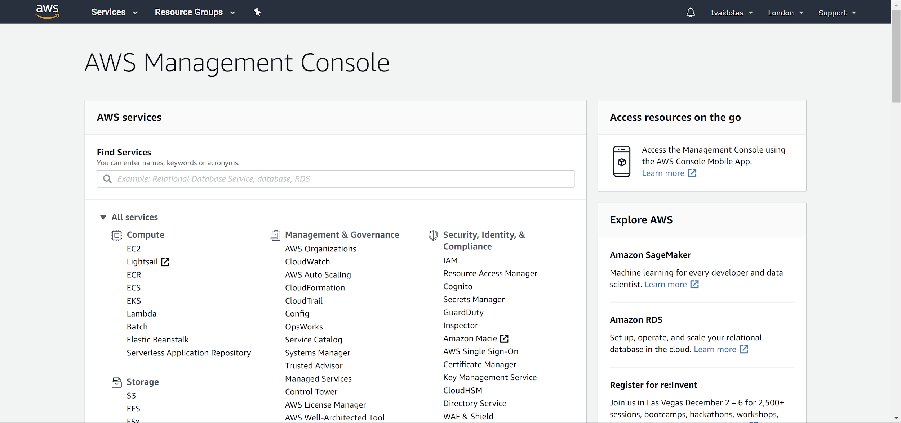
AWS

Slide 6
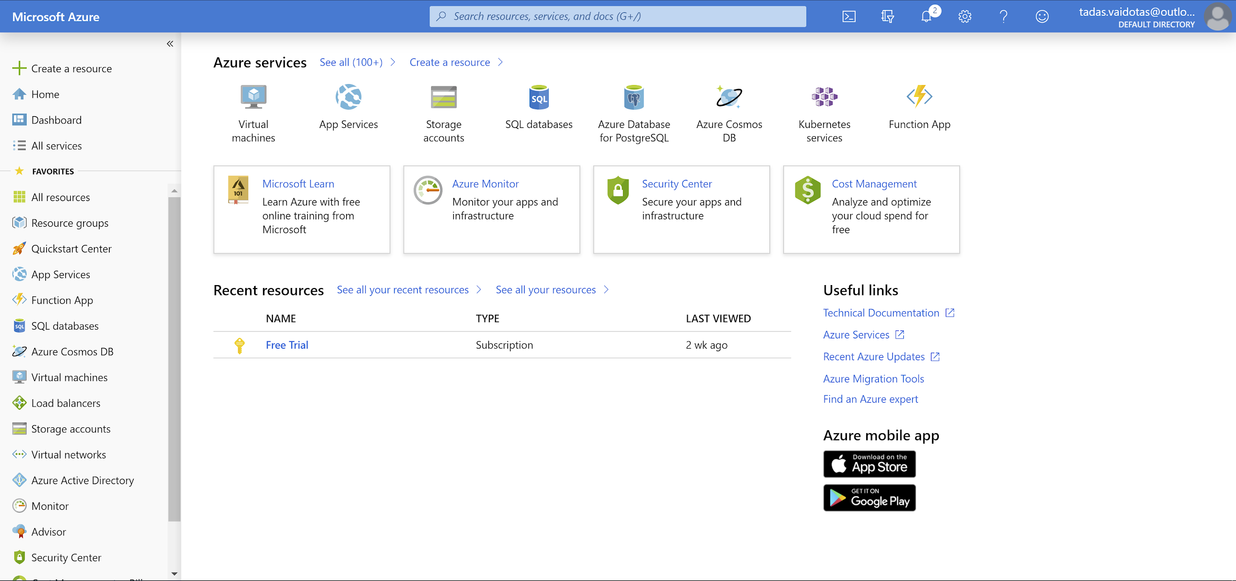
Azure

Slide 7
Consumption based pricing
the customer pays according to the amount of resources used.
The prices may have flat rates per resource or they could be varied rates for different components.

Slide 8
Broad network access
Access over network via standard mechanisms which would generally be taken to mean standard protocols like HTTP or TCP.
Services should be accessible to a variety of clients running on various hardware (phones, laptops, desktops).
Notice that network-accessible is not the same thing as internet-accessible;

Slide 9
Resource pooling
Cloud services are provided to multiple tenants (users, applications) by a pool of interchangeable resources
Providing on-demand resources with utility pricing can only make economic sense if the resources come from a shared pool.
These resources are dynamically assigned and reassigned in order to get optimal use of out of them.
Storage, processing, memory, etc.
Location independent
The customer generally does not know, or need to know the exact physical location of the resources
For regulatory and architectural reasons, the customer is generally able to specify a general location; such as the country.
e.g. can this data be stored outside of the EU?
Can the application function well if the web-server is in the EU and the data it uses is in Australia?

Slide 10
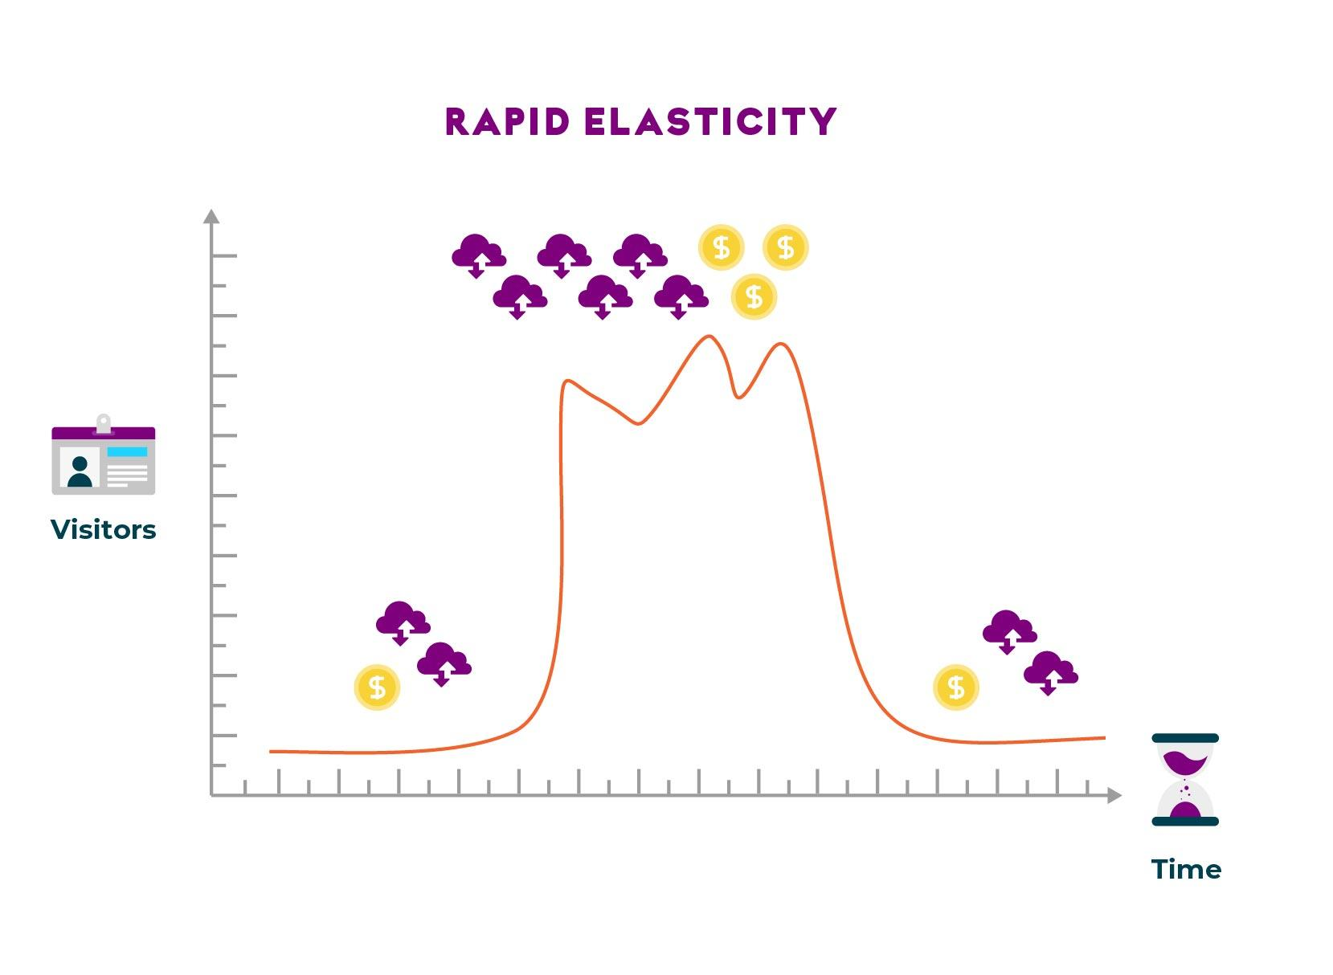
Rapid Elasticity
the ability to use exactly the resources you need, without either under-provisioning or excessively over-provisioning
It allows the customer to dynamically scale compute resources based on demand. There are two ways to scale resources:
Horizontally (in/out) - adding/removing instances
Vertically (up/down) - increasing/decreasing resources (e.g. CPU/RAM) for instances

Slide 11
Measured Services
If resources are being dynamically provisioned, it’s essential that the customer should be able to monitor the performance and usage of those resources in real time.
Most cloud resources are offered on a pay-per-use basis, and the customer must be able to monitor their usage in order to control their costs.

Slide 12
Fault tolerance
Fault tolerance concept exists not only in the cloud but also in the self-hosted environment. What this is referring to is the ability for your application to function even if part of your infrastructure fails.
In the cloud, you have auto-scaling as well as multiple geographical zones to help you aid with fault tolerance.

Slide 13
Economies of Scale
Cost advantages experienced by companies when the level of output increases is known as Economies of scale.
advantage comes from the relationship between per-unit cost and the quantity produced
Simply, as productions scale, they end to be cheaper on a per-unit basis

Slide 14
Capital expenditure
Capital expenditure (CapEx) are funds that companies use to upgrade, maintain and acquire physical assets like buildings, technology and equipment
can tell you how much they are investing in new or existing assets for growing or maintaining the company
Operational Expenditure (OpEx) is short term expenses that keep the business running
may include maintenance costs and utilities
CapEx and OpEx are not interchangable
Migrating infrastructure to the cloud means that all your IT CapEx gets transformed into OpEx

